Slide 1
Microsoft 365 Administration Fundamentals
Speaker Name

Slide 3
Overview Microsoft 365 Admin Center
Notes:
Lets explore the quickest way to administrate Microsoft 365 using Microsoft 365 Admin Center

Slide 4
Objectives
After completing this lesson, you will be able to:
Understand and explain various management interfaces available to you in Microsoft 365.
Manage service-specific features and settings
Manage various Microsoft 365 services by using the GUI and Windows PowerShell.

Slide 5
Microsoft 365 Administration Fundamentals
There are two possible ways to administer Microsoft 365
Using Management Interfaces
Using Management Shells/APIs
Notes:
Microsoft Microsoft 365 Admin Center
A web portal from which an administrator can manage user accounts, licenses, domains, and settings for each of the Microsoft 365 services to which they subscribe.
Accessed from https://portal.office.com
Users access the same URL but get a different view rendered (depending on the permissions assigned).
Azure Active Directory Module for Windows PowerShell
The Windows PowerShell equivalent of the Microsoft 365 Admin Center
The Azure Active Directory PowerShell for Graph module does not completely replace the functionality in the cmdlets of Microsoft Azure Active Directory Module for Windows PowerShell module for user, group, and license administration. In many cases, you need to use both versions. You can safely install both versions on the same computer.
Also see Connect to all Microsoft 365 services in a single Windows PowerShell window
https://docs.microsoft.com/en-us/office365/enterprise/powershell/connect-to-all-office-365-services-in-a-single-windows-powershell-window

Slide 6
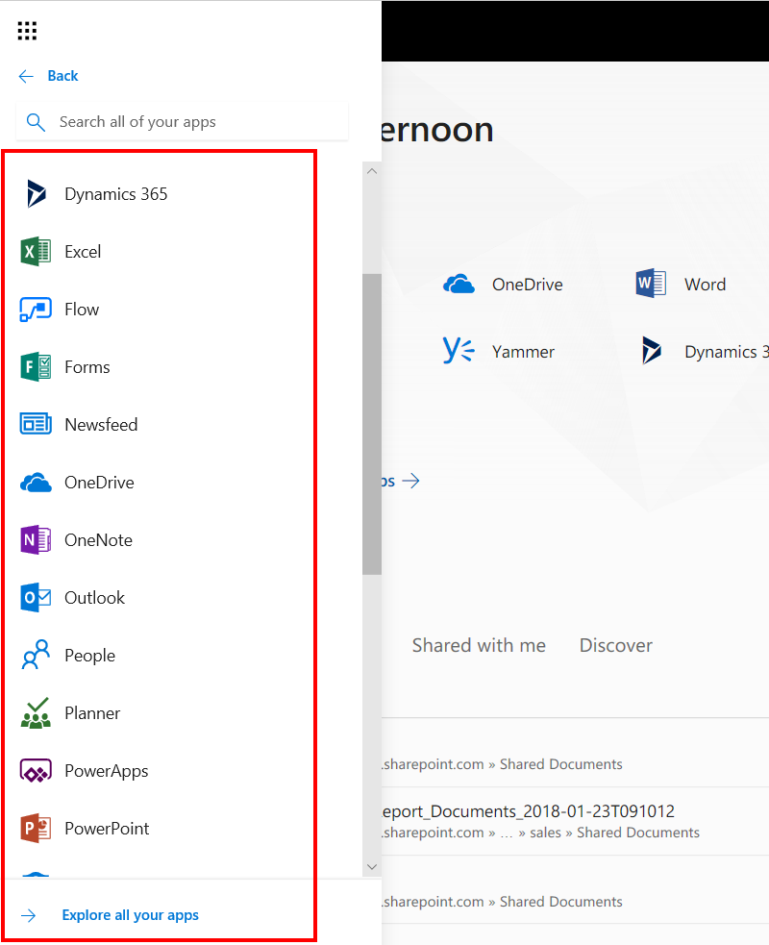
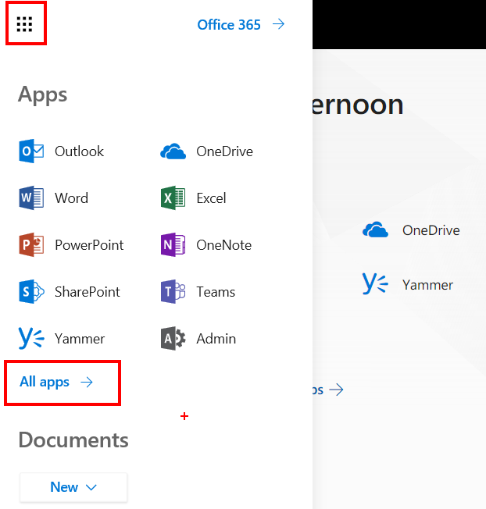
Microsoft 365 Portal: App Launcher
Notes:
Options for app launch tiles
- Open in a new tab
- Unpin from app launcher
- Pin to navigation bar
- Resize

Slide 7
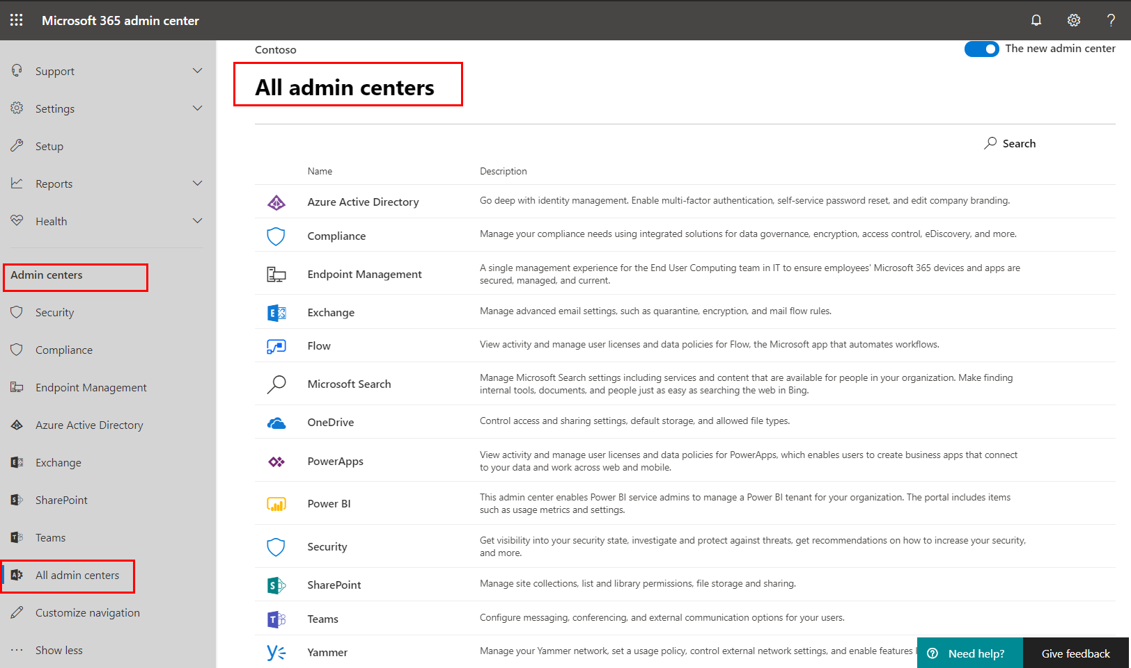
Microsoft 365 Admin Center: Administration View
Notes:
Point to different Admin Centers available for specific administration tasks and just talked about SharePoint Admin Center (This is not a place where we go into details of SharePoint Admin Center)

Slide 8
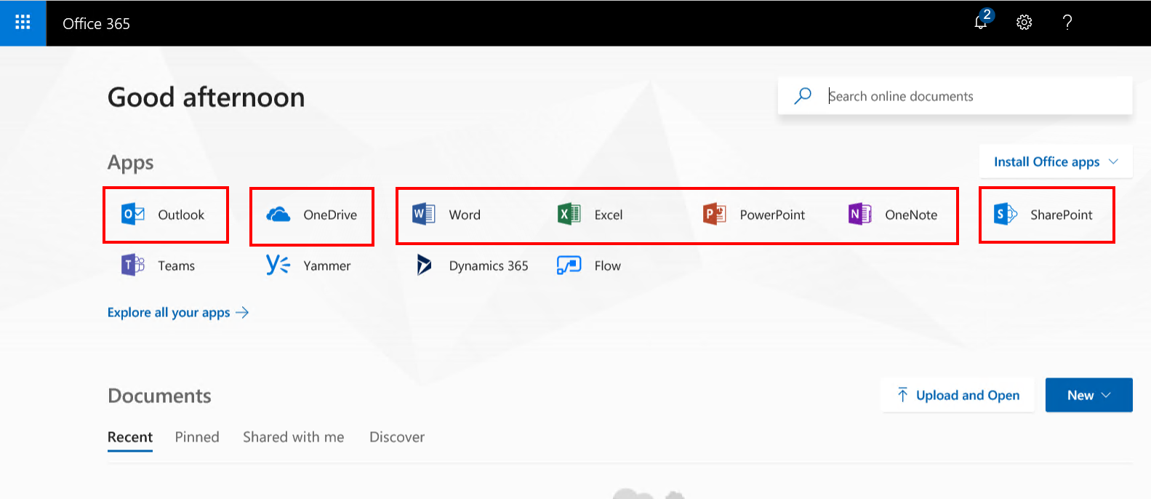
Microsoft 365 Portal: End-User View
Connects to tenant’s SharePoint Home page
Connects to Outlook on the Web
Connects to OneDrive for Business
Connects to Office Web Apps

Slide 9
Overview Microsoft 365 Management Shells

Slide 10

Windows PowerShell
Windows PowerShell can be used to connect to and manage Microsoft 365
Microsoft Azure Active Directory Module
The Azure Active Directory Module is being replaced by the Microsoft Graph PowerShell SDK
SharePoint Online Management Shell
PowerShell for Exchange Online
Skype for Business Online/Microsoft Teams Windows PowerShell Module
Security & Compliance Center PowerShell
Notes:
For a listing of The Azure Active Directory PowerShell for Graph module cmdlets see
https://docs.microsoft.com/en-us/powershell/module/Azuread/?view=azureadps-2.0
NOTE: Microsoft will begin to deprecate the Azure ActiveDirectory (MSOnline) module when the functionality of that module is migrated to the newer Azure Active Directory PowerShell for Graph Module.
Microsoft advises customers who are creating new PowerShell scripts to use the newer module instead of this module.
Although not to the extent of SharePoint on-premises, you can use Windows PowerShell to manage your SharePoint Online organization. Windows PowerShell is especially useful for bulk operations and for accessing settings that may not be available in the SharePoint Admin Center. You can use Remote PowerShell on a local computer to connect to your SharePoint Online organization.
Remote PowerShell allows you to:
Use scripts to automate routine tasks. For example, you can create or update many user accounts or site collections at the same time. You can use the same PowerShell commands and syntax as you would for other Windows Server products on-premises.
The SharePoint Online Management Shell, uses Secure Sockets Layer (SSL) port 443 to connect to the datacenter using the standard HTTPS protocols.
For more information on the SharePoint Online Management shell and an index of it’s cmdlets, see:
http://technet.microsoft.com/en-us/library/fp161362(v=office.15).aspx

Slide 11
Azure Active Directory PowerShell for Graph
Azure Active Directory PowerShell for Graph includes cmdlets that mirror actions that can be completed by customers in the Microsoft 365 portal:
Provides all the cmdlets that are required to configure Identity Federation On-Premises.
The Azure AD module is distributed using the PowerShell gallery.
Installing items from the Gallery requires the latest version of the PowerShellGet module, which is available in Windows 11, in Windows Management Framework (WMF) 5.0, or in the MSI-based installer (for PowerShell 3 and 4).
Install using Install-Module AzureAD OR Install-module AzureADPreview (Preview).
Connect to Microsoft 365 by typing Connect-AzureAD and entering the credentials of a Microsoft 365 administrator in the dialog box.
Notes:
For more detail and steps on installing the Azure Active Directory PowerShell for Graph module and connecting to AzureAD see
https://docs.microsoft.com/en-us/powershell/azure/active-directory/install-adv2?view=azureadps-2.0

Slide 12
Remote PowerShell for SharePoint Online
No need to install SharePoint Server management tools in order to use the SharePoint Online Management Shell
To connect to SharePoint Online using the Management Shell, perform the following steps:
Open the SharePoint Online Management Shell
Create a new remote session to the SharePoint Online tenant with following cmdlet (Use your administrative account)
Connect-SPOService -Url https://<tenantname>-admin.sharepoint.com
Notes:
Set up the SharePoint Online Management Shell environment
SharePoint Online global administrators use the SharePoint Online Management Shell to do the following:
Remotely manage site collections.
Upgrade site collections to a new version.
Configure SharePoint Online company-level settings like NoAccessRedirectUrl.
Get logs from data connections between SharePoint Online and other services through Business Connectivity Services.
Note: You might need to set your Windows PowerShell execution policy by specifying the following command:
Set-ExecutionPolicy –ExecutionPolicy RemoteSigned
To set up the SharePoint Online Management Shell environment, follow these steps
Install Windows Management Framework 3.0 from http://www.microsoft.com/en-us/download/details.aspx?id=34595
Install SharePoint Online Management Shell from http://www.microsoft.com/en-us/download/details.aspx?id=35588
Click Start, click All Programs, and then click SharePoint Online Management Shell.
Run Connect-SPOService (For more information, see: http://technet.microsoft.com/en-us/library/fp161392) For example, type this command at the prompt:
Connect-SPOService -Url https://contoso-admin.sharepoint.com - credential admin@contoso.com, where:
Url is the URL of the SharePoint Online Administration Center.
Credential is the user name to which you want to grant access to the SharePoint Online Administration Center site.
Run Get-SPOSite (For more information, see: http://technet.microsoft.com/en-us/library/fp161380) to get a list of all the sites.

Slide 13
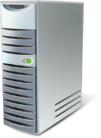
Windows PowerShell Endpoints
SharePoint Online
SharePoint Administration Center
https://tenant-admin.sharepoint.com
Online Services Licensing
Microsoft 365 Admin Center
https://admin.microsoft.com
Azure Active Directory
https://portal.azure.com
Remote PowerShell for SharePoint Online
On-Premises
Azure Active Directory PowerShell for Graph
Notes:
This slide demonstrates the two distinct connection points that are used when using Windows PowerShell.
Note: You might need to set your Windows PowerShell execution policy by specifying Set-ExecutionPolicy –ExecutionPolicy RemoteSigned
Azure Active Directory PowerShell for Graph connects to an instance of Azure Active Directory (Azure AD). When this module is first installed, all cmdlets are installed locally on the client.
The SharePoint Online Management Shell connects to the SharePoint Online component of your tenant and contains the available cmdlets for SharePoint Online.

Slide 14
Example: Assigning Licenses
You can manage Microsoft 365 licenses using
Microsoft 365 Admin Center (Management Interface)
Azure Active Directory PowerShell for Graph (Management Shell)
Group-based licensing in Azure Active Directory (Management Interface)
Best practice:
Group based licensing in Azure Active Directory.
If a SharePoint license is assigned, and then removed:
A user’s content in SharePoint Online will remain in SharePoint Online
The Users OneDrive for Business will remain and will not go into a clean-up or deletion process
The OneDrive for Business clean-up process only occurs when the user’s account is no longer in Azure AD
User still shows up in people-picker
Notes:
Now, when we have explored different options to administrate Microsoft 365 so lets have a look at an example of assigning licenses to individuals.
You can see that this is possible with
Either using a Management Interfaces like Microsoft 365 Admin Center
OR from the Azure Active Directory PowerShell for Graph
Event with Azure AD connect tool with group-bases licensing.

Slide 15
Understanding Microsoft 365 Domains

Slide 16
The Microsoft Online Default Routing Domain
Is in the format of contoso.onmicrosoft.com
Created automatically and assigned to the first user at sign up
Fully functional for Simple Mail Transport Protocol (SMTP) and Session Initiation Protocol (SIP) addresses out-of-the-box
Enables service usage right away
Cannot be removed or renamed*
No requirement to use it if adding your own domain
*Still in preview. There is an option to change SharePoint domain name https://docs.microsoft.com/en-us/sharepoint/change-your-sharepoint-domain-name
Notes:
Your onmicrosoft.com domain in Microsoft Microsoft 365
Microsoft 365 creates a domain for you, such as contoso.onmicrosoft.com, when you sign up with the service. The user ID that you create when you sign up includes the domain, such as eli@contoso.onmicrosoft.com. You can keep using this domain for your user ID and for other users that you add to your account. Some people do this while using a trial version.
Your initial onmicrosoft.com and SharePoint domains
Your Microsoft 365 account has two initial domains: an onmicrosoft.com domain and a SharePoint Online domain.
You can use your onmicrosoft.com domain (like fourthcoffee.onmicrosoft.com) with most Microsoft 365 such as Microsoft Exchange Online and Skype for Business.
Note: You cannot rename your initial onmicrosoft.com domain after you choose that domain at sign-up. For example, if the initial domain you chose during Microsoft 365 signup was fourthcoffee.onmicrosoft.com, you cannot change it to be fabrikam.onmicrosoft.com. To use a different onmicrosoft.com domain, you would have to open a new account with Microsoft 365.

Slide 17
Using Your Own Domain in Microsoft 365
Applies to user’s SMTP and SIP addresses
For example: user@contoso.com instead of user@contoso.onmicrosoft.com
Used for the Microsoft Outlook on the Web URL
https://outlook.com/owa/contoso.com
Used as the user’s Microsoft Online Services ID credentials
Notes:
Why add your own domain? What can you do with it?
When people are ready to use Microsoft 365 for their business, most would rather have email (and a website) that includes their own domain, like fourthcoffee.com. To be clear: there is no requirement to add your own domain; you can keep using the onmicrosoft.com domain with Microsoft 365 and never switch. But using your own domain lets you have an easy-to-remember Microsoft 365 email address (which is also your user ID) and website URL for your business.
Let us suppose that you decide to add your custom domain to Microsoft 365. After you finish, when you look in your list of domains in Microsoft 365, you will see the domain you added, such as fourthcoffee.com, and the initial domain—the one that includes onmicrosoft.com.
For example, now you can:
Use your domain with email addresses
After you add your domain, you can change users’ email addresses to use the more familiar domain name.
Go to Admin > Users and groups.
Click the user that you want to edit, and then click Edit.
For the user’s email address, click the drop-down list, and then choose your custom domain name.

Slide 18
Before Adding Your Domain to Microsoft 365
You must already own the domain
Domain must not already be in use by another Microsoft 365 tenant
You must be able to create public DNS records for your domain
Notes:
Before you set up your domain, keep in mind the following:
To add a domain, you must have already registered a domain and have the sign-in credentials needed for your domain name registrar.
If you are currently using custom domains with another Microsoft cloud service, you cannot add the same domains to Microsoft 365.
You can add multiple domains to Microsoft 365. However, you cannot add the same domain to different Microsoft 365 tenants.
You can add a domain name to Microsoft 365 by using any of the following:
The Add your domain wizard in the Microsoft 365 Admin Center.
The New-AzureADDomain cmdlet in the Microsoft Azure Active Directory Module for Windows PowerShell.

Slide 19
Knowledge Check
What is the URL for the Microsoft 365 Admin Center?
What is the URL for the SharePoint Administration Center?
What are the possible ways of managing licenses?
What happens if you remove a SharePoint license from a user?
https://admin.microsoft.com
https://<tenantname>-admin.sharepoint.com
Using Management Interfaces like Microsoft 365 Admin Center OR Azure Admin Portal
A user’s content in SharePoint Online will remain in SharePoint Online
The Users OneDrive for Business will remain and will not go into a clean-up or deletion process when the users SPO license is removed
The OneDrive for Business clean-up process only occurs when the user’s account is no longer in Azure AD.
Can you remove or rename the default Microsoft Online domain?
No
Using Azure Active Directory PowerShell for Graph

Slide 20
Summary
In this lesson, you learned about:
Microsoft 365 and SharePoint Administration Centers
About the default Microsoft Online domain and its purpose
About incorporating company-owned domains into Microsoft 365
The differences between the Azure Active Directory module for Windows PowerShell and Remote PowerShell

